Slide 1










PLAYER 1
HIGHSCORE 2500
PLAYER 2
STRIKECORE INTERACTIVE REFLEX HUB
Presented by Team xyz

Slide 2














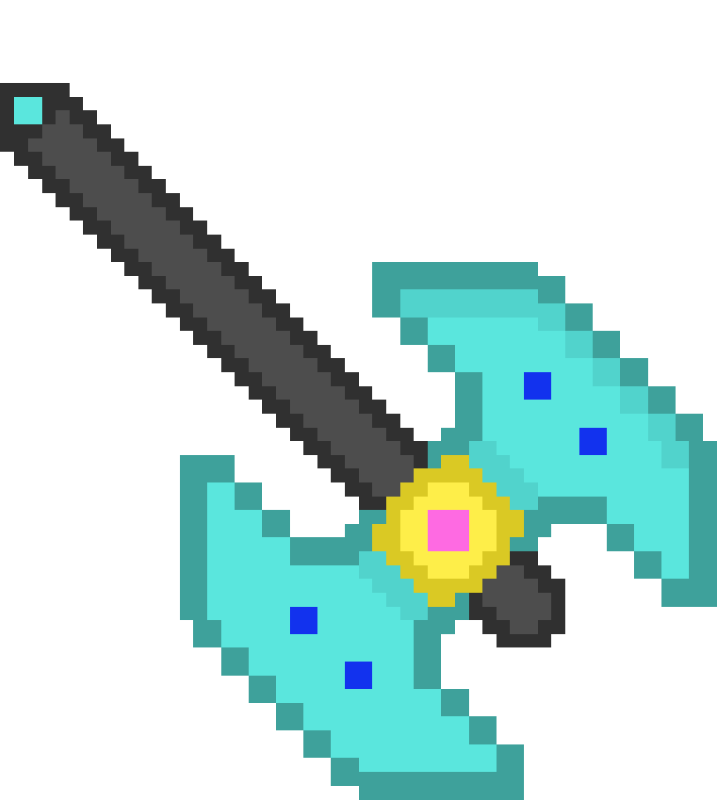


01
07
12
CONTENTS
Problem statement
Working Process
impacts & benefits
key features
future impropvements
proposed solution
prototype demostration
conclusion
system architecture
Hardware components
innovation and uniqueness

Slide 3

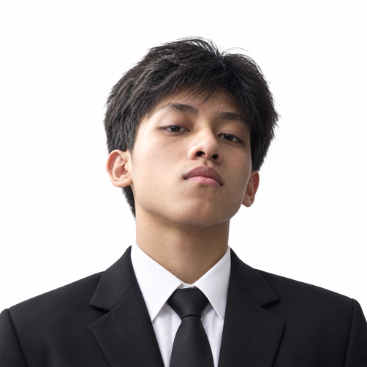


TEAM XYZ
Thet Htoo Zaw
Min Thant Kyaw
Hnin Pwint Phyu
Thoon YuPar Zin

Slide 4

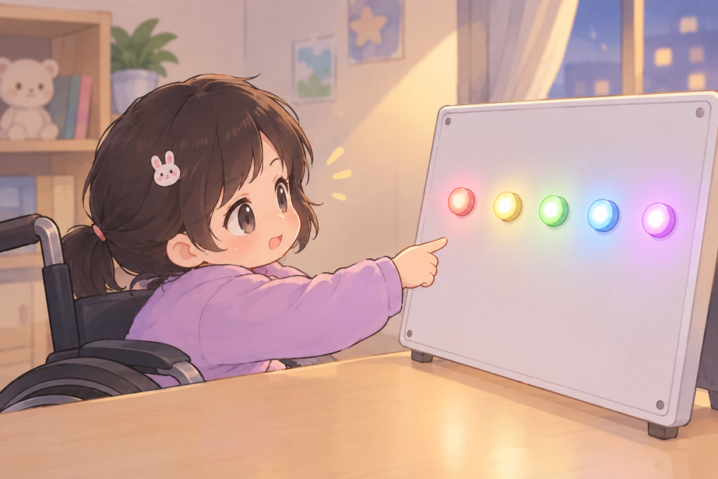

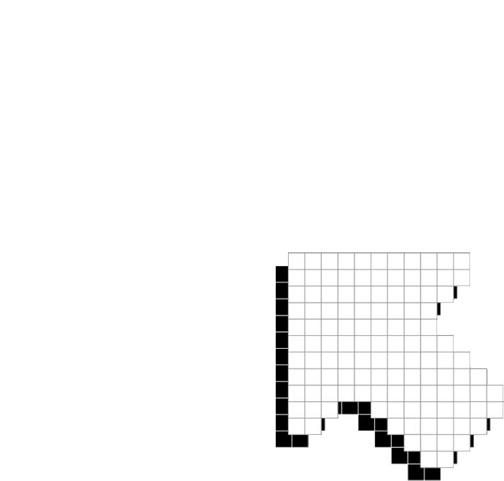

01
07
12
PROBLEM
STATEMENT
Children with disabilities may have difficulties with eye-hand coordination
Limited reaction speed and movement control
Traditional exercises can be repetitive and less engaging
Need for a fun and interactive training system

Slide 5



01
07
12
PROPOSED
SOLUTION
  IoT-based interactive reflex training game
  Designed for children with disabilities
  Uses multiple sensors for interactive activities
  Provides real-time visual and audio feedback
  Includes adjustable difficulty levels

Slide 6

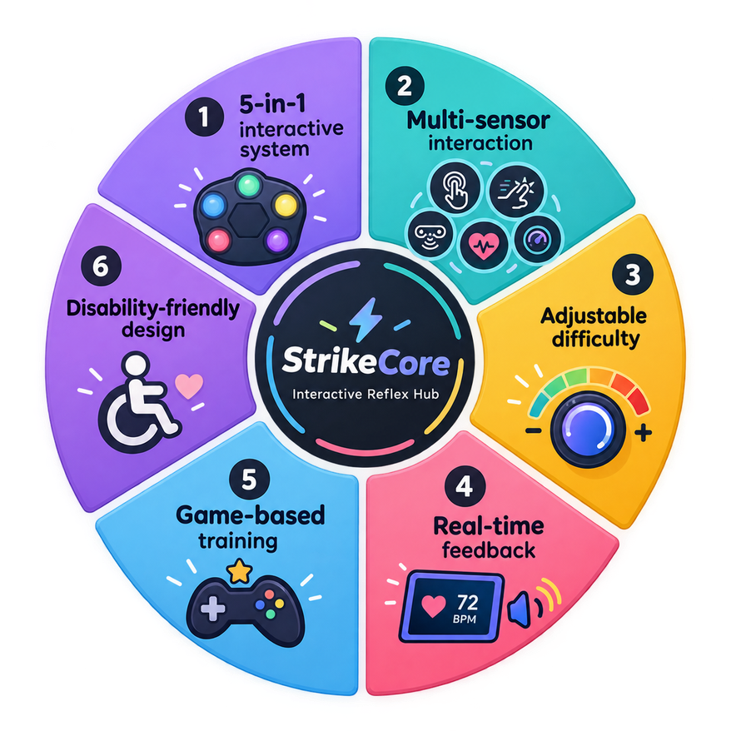
HIGHSCORE 2500
PLAYER 2
INNOVATION
AND
UNIQUENESS

Slide 7

SYSTEM ARCHITECTURE
  Dual-ESP32 Microcontroller Design
  ESP32-1 (Game Controller): LEDs & Touch sensors, potentiometer.
  ESP32-2 (IoT Smart Hub): Biometric sensors, OLED, Environment sensors, Web Dashboard
  ESP-NOW Wireless Protocol
  Access-point mode (off-line)

Slide 8
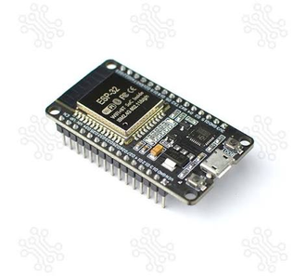
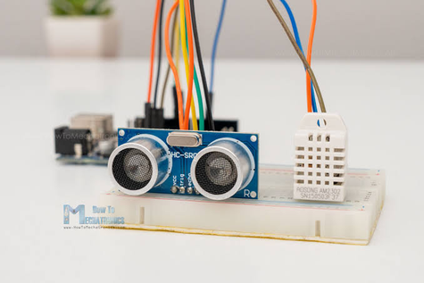
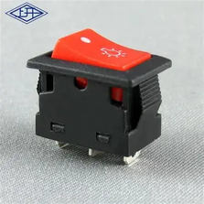
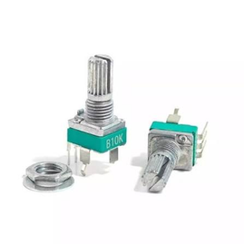
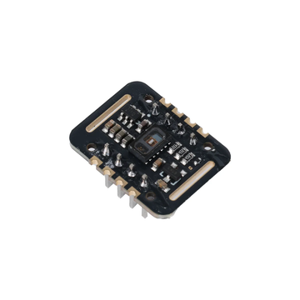
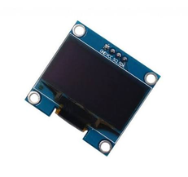
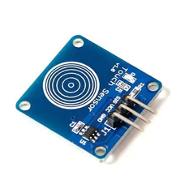
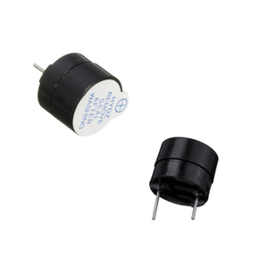
HARDWARE
COMPONENTS
ESP32 MICROCONTROLLERS, SWITCH BUTTON
DHT22 & ULTRASONIC SENSOR
MAX30102 AND TOUCH SENSOR
POTENTIOMETER OLED, BUZZER

Slide 9

Back to Agenda Page
01
07
12
Step 1 - Biometric Scan
WORKING
Step 2 - Preparation Phase
Step 3 - Active Gameplay
PROCESS
Step 4 - Real-time Feedback

Slide 10

Health Integrated Training
Direct Potentiometer Speed Control
IoT Web Dashboard
Safety Proximity Alert
KEY FEATURES
Back to Agenda Page
Highlight two or more cells, right-click then choose "Merge Cells" to organize your table according to your needs!

Slide 11








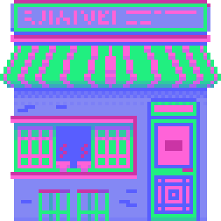

IMPACTS AND BENEFITS

Slide 12

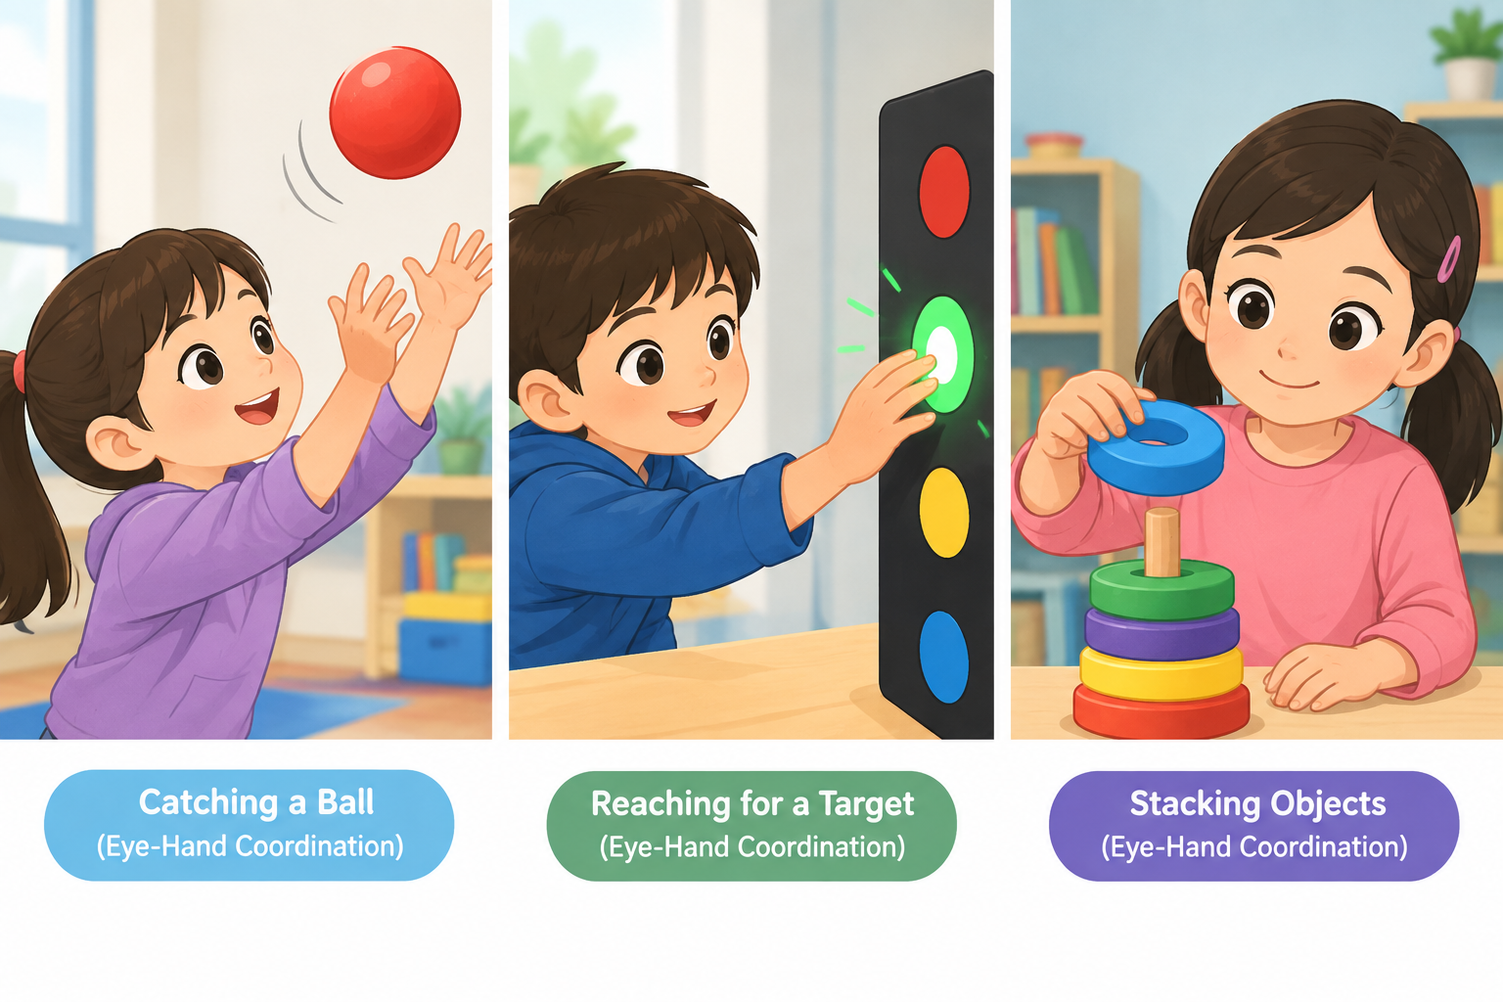
improves eye-hand coordinaton

Slide 13
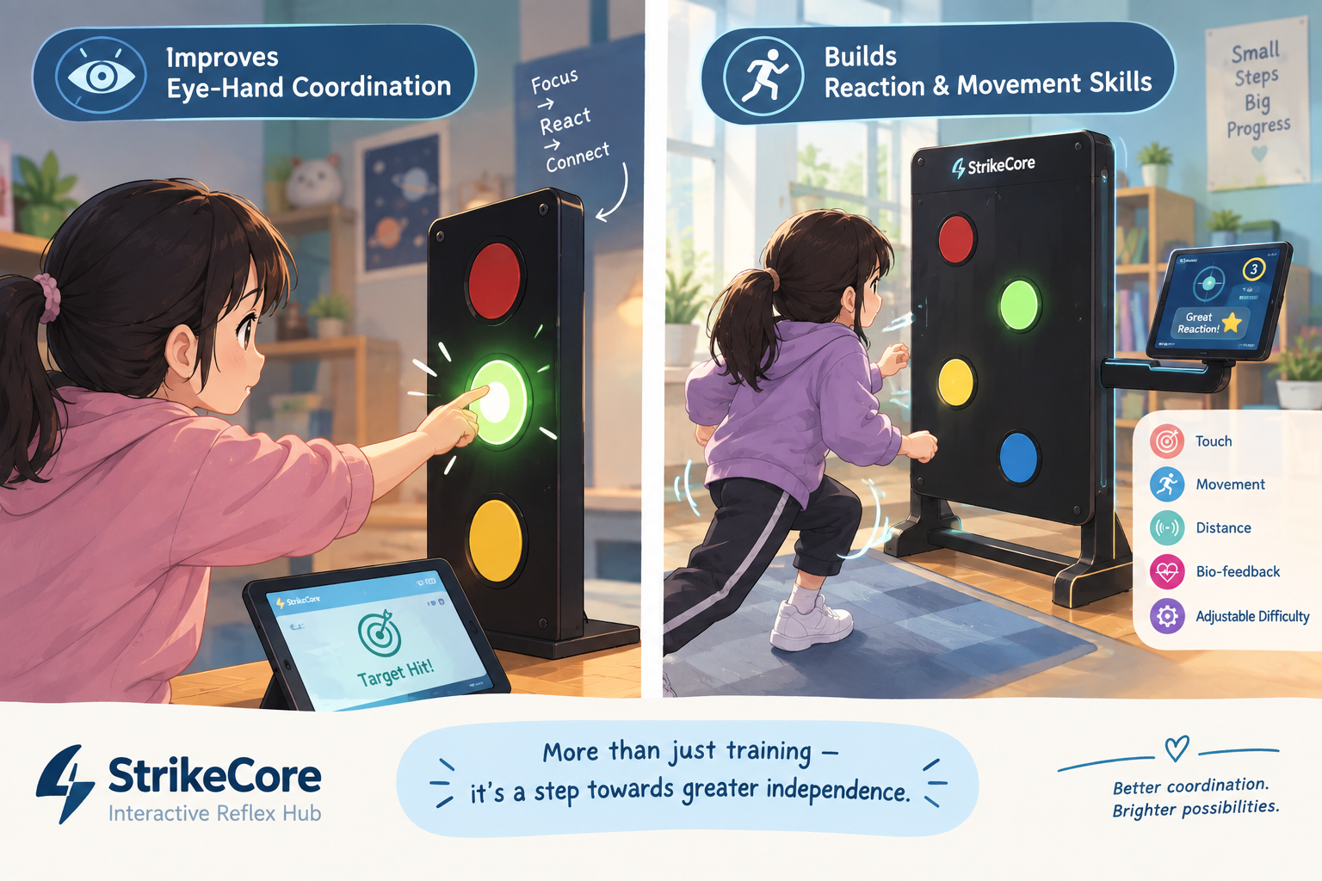
Builds reaction & movement skills

Slide 14
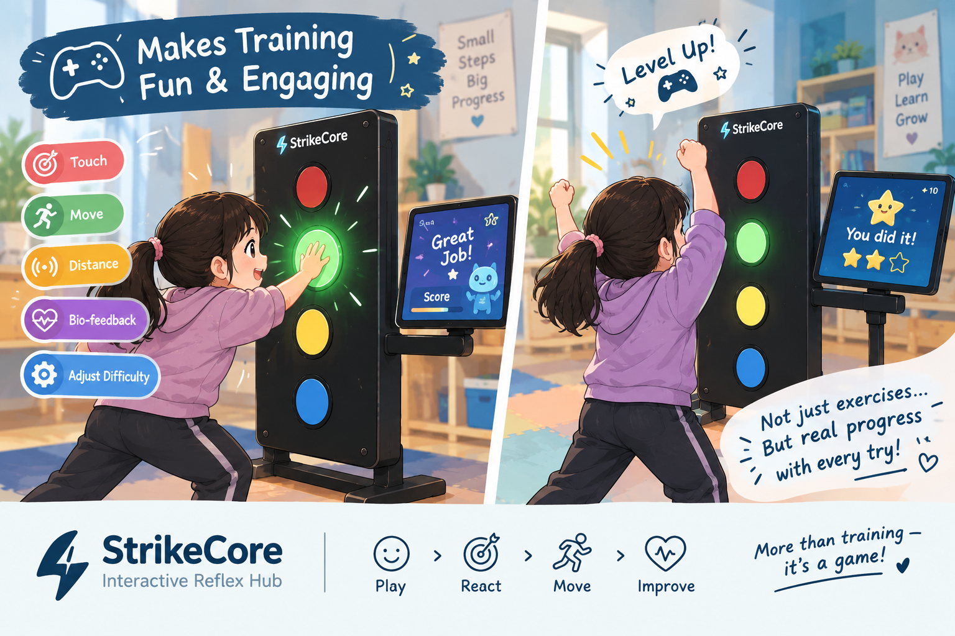
Makes training fun & engaging

Slide 15
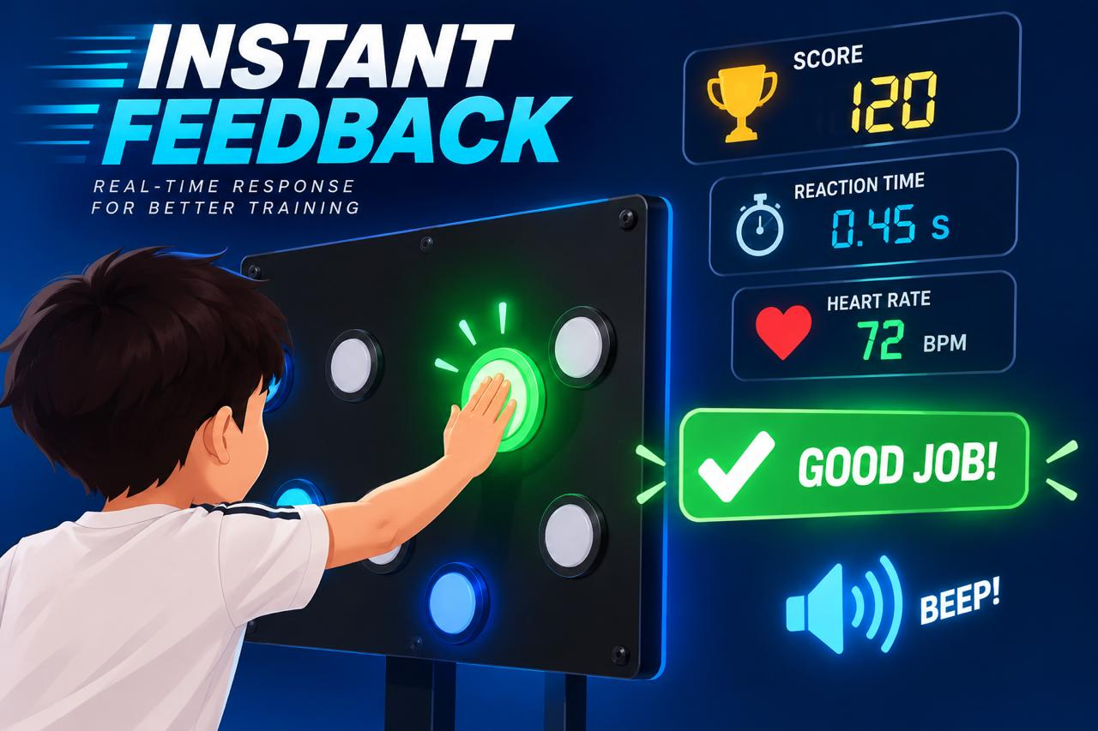
Gives instant feedback

Slide 16
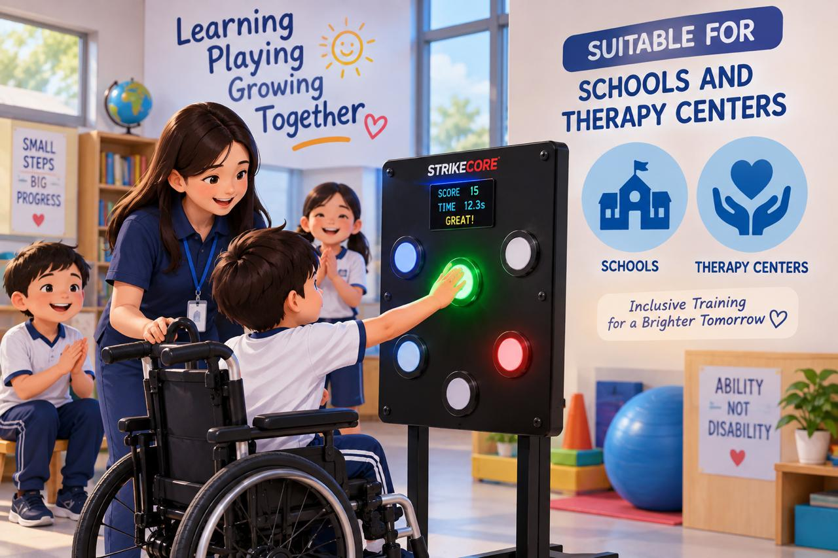
suitable for schools and therapy centers

Slide 17
200000$
Prototype Cost: [Actual Cost]

Slide 18
Back to Agenda Page
01
07
12
FUTURE
Add the strong frame, and more attraction and related sensors .
Multi-User Support
IMPROVEMENTS

Slide 19
CONCLUSION
  IoT-based interactive reflex training system
  Supports coordination, reaction, and movement skills
  Makes training fun and engaging
  Provides real-time feedback
  Can be improved with more training modes and multi-user support

Slide 20
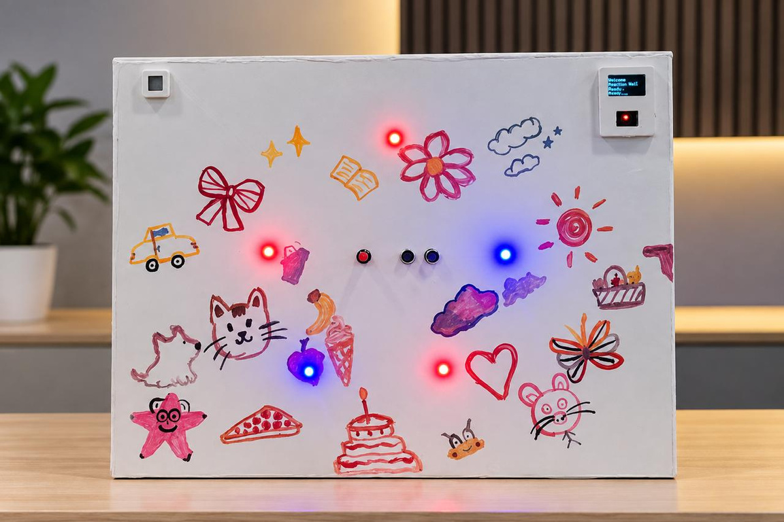
PROTOTYPE DEMONSTRATION

Slide 21




THANK YOU!
INSERT A PARTING OR
call-to-action message here.

Slide 22


